Slide 1
EXPOSYS DATA LABS
Data Science Project : Customer Segmentation
Presenter’s name : Himanshu Verma
Institute : IIT BHU Varanasi
Branch : Metallurgical Engineering

Slide 2
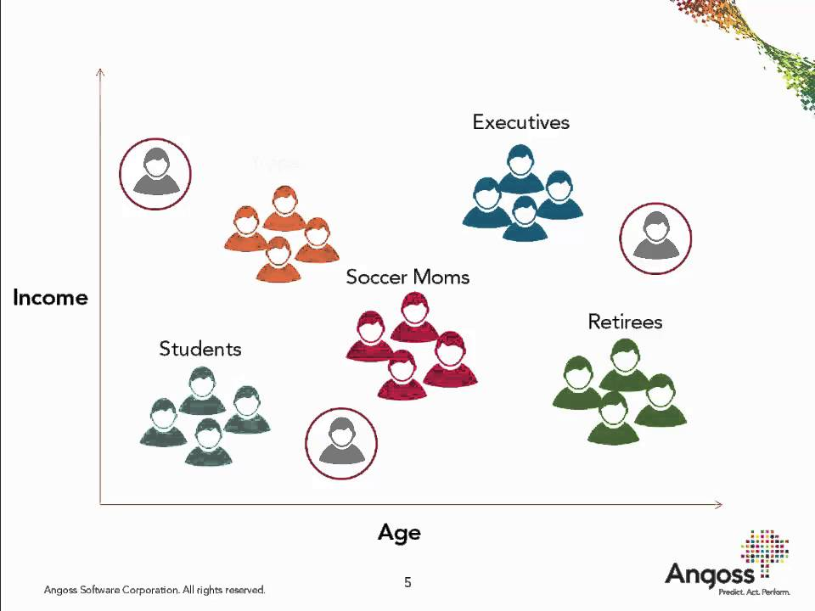
Customer Segmentation
Customer Segmentation is the subdivision of a market into discrete customer groups that share similar characteristics. Customer Segmentation can be a powerful means to identify unsatisfied customer needs. Using the above data companies can then outperform the competition by developing uniquely appealing products and services.
The most common ways in which businesses segment their customer base are:
Demographic information, such as gender, age, familial and marital status, income, education, and occupation.
Geographical information, which differs depending on the scope of the company. For localized businesses, this info might pertain to specific towns or counties. For larger companies, it might mean a customer’s city, state, or even country of residence.
Psychographics, such as social class, lifestyle, and personality traits.
Behavioral data, such as spending and consumption habits, product/service usage, and desired benefits.

Slide 3
Advantages of Customer Segmentation
Determine appropriate product pricing.
Develop customized marketing campaigns.
Design an optimal distribution strategy.
Choose specific product features for deployment.
Prioritize new product development efforts.
The Challenge
We owing a supermarket mall and through membership cards, and we have some basic data about customers like Customer ID, age, gender, annual income and spending score. We wanted to understand the customers like who are the target customers so that the sense can be given to marketing team and plan the strategy accordingly. Then analyze their annual incomes and spending scores.

Slide 4
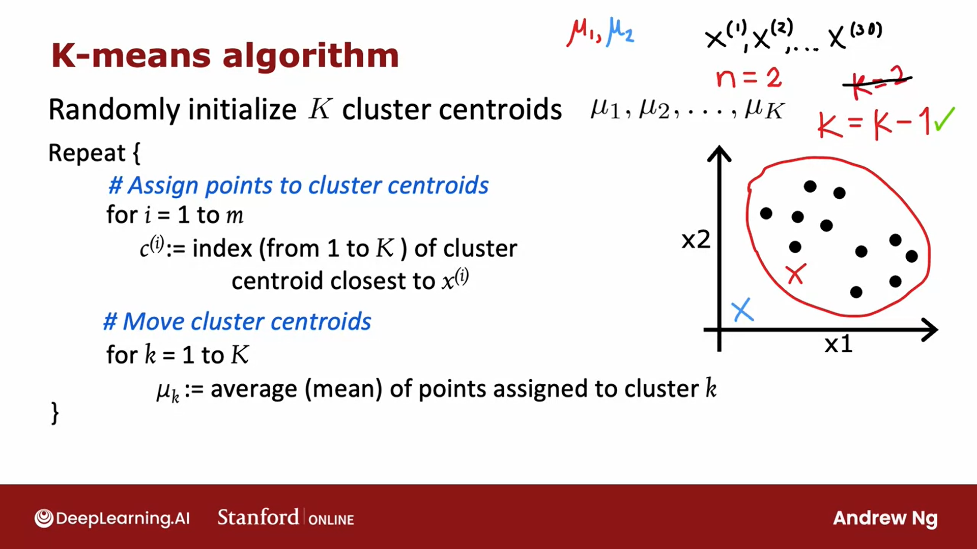
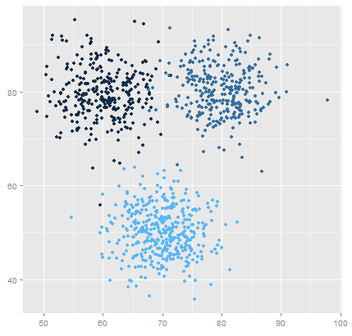
K Means Clustering Algorithm
Specify number of clusters K.
Initialize centroids by first shuffling the dataset and then randomly selecting K data points for the centroids without replacement.
Keep iterating until there is no change to the centroids. i.e assignment of data points to clusters isn’t changing.

Slide 5
Data
This project is a part of the Mall Customer Segmentation Data.
The dataset can be downloaded from here : (https://drive.google.com/file/d/19BOhwz52NUY3dg8XErVYglctpr5sjTy4/view)
Environment and tools
scikit-learn
seaborn
numpy
pandas
matplotlib

Slide 6
Steps
I started with loading all the libraries and dependencies. The columns in the dataset are customer id, gender, age, income and spending score.
I dropped the id column as that does not seem relevant to the context. Also I plotted the age frequency of customers.
Next I made a box plot of spending score and annual income to better visualize the distribution range. The range of spending score is clearly more than the annual income range.
I made a bar plot to check the distribution of male and female population in the dataset. The female population clearly outweighs the male counterpart.
Next I made a bar plot to check the distribution of number of customers in each age group. Clearly the 26–35 age group outweighs every other age group.

Slide 7

I continued with making a bar plot to visualize the number of customers according to their spending scores. The majority of the customers have spending score in the range 41–60.
Also I made a bar plot to visualize the number of customers according to their annual income. The majority of the customers have annual income in the range 60000 and 90000.
Next I plotted Within Cluster Sum Of Squares (WCSS) against the the number of clusters (K Value) to figure out the optimal number of clusters value. WCSS measures sum of distances of observations from their cluster centroids which is given by the below formula.
where Yi is centroid for observation Xi. The main goal is to maximize number of clusters and in limiting case each data point becomes its own cluster centroid.

Slide 8
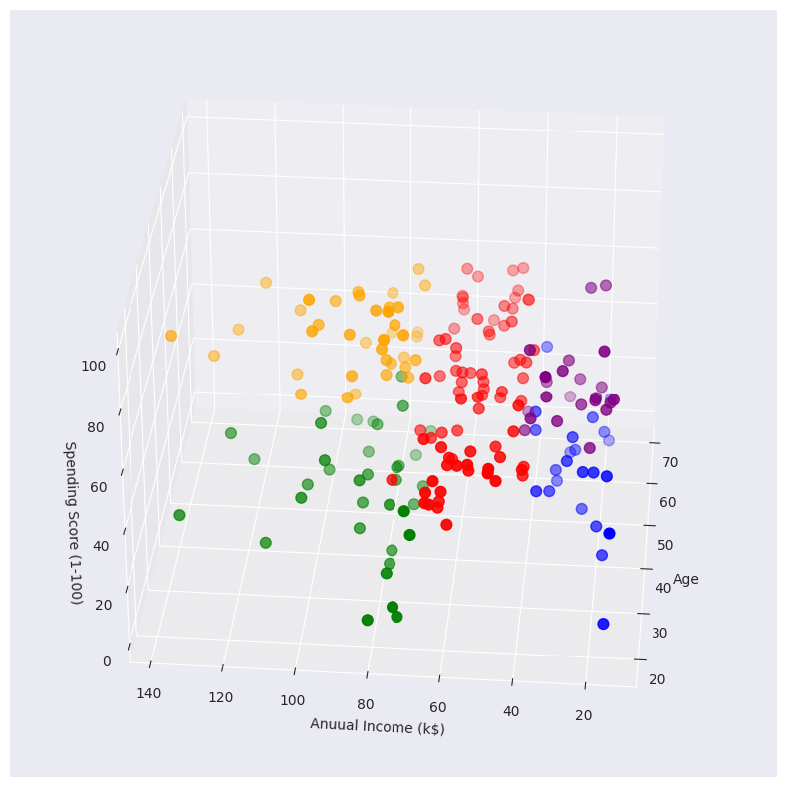
Results
Conclusions
K means clustering is one of the most popular clustering algorithms and usually the first thing practitioners apply when solving clustering tasks to get an idea of the structure of the dataset. The goal of K means is to group data points into distinct non-overlapping subgroups. One of the major application of K means clustering is segmentation of customers to get a better understanding of them which in turn could be used to increase the revenue of the company.

